Slide 1
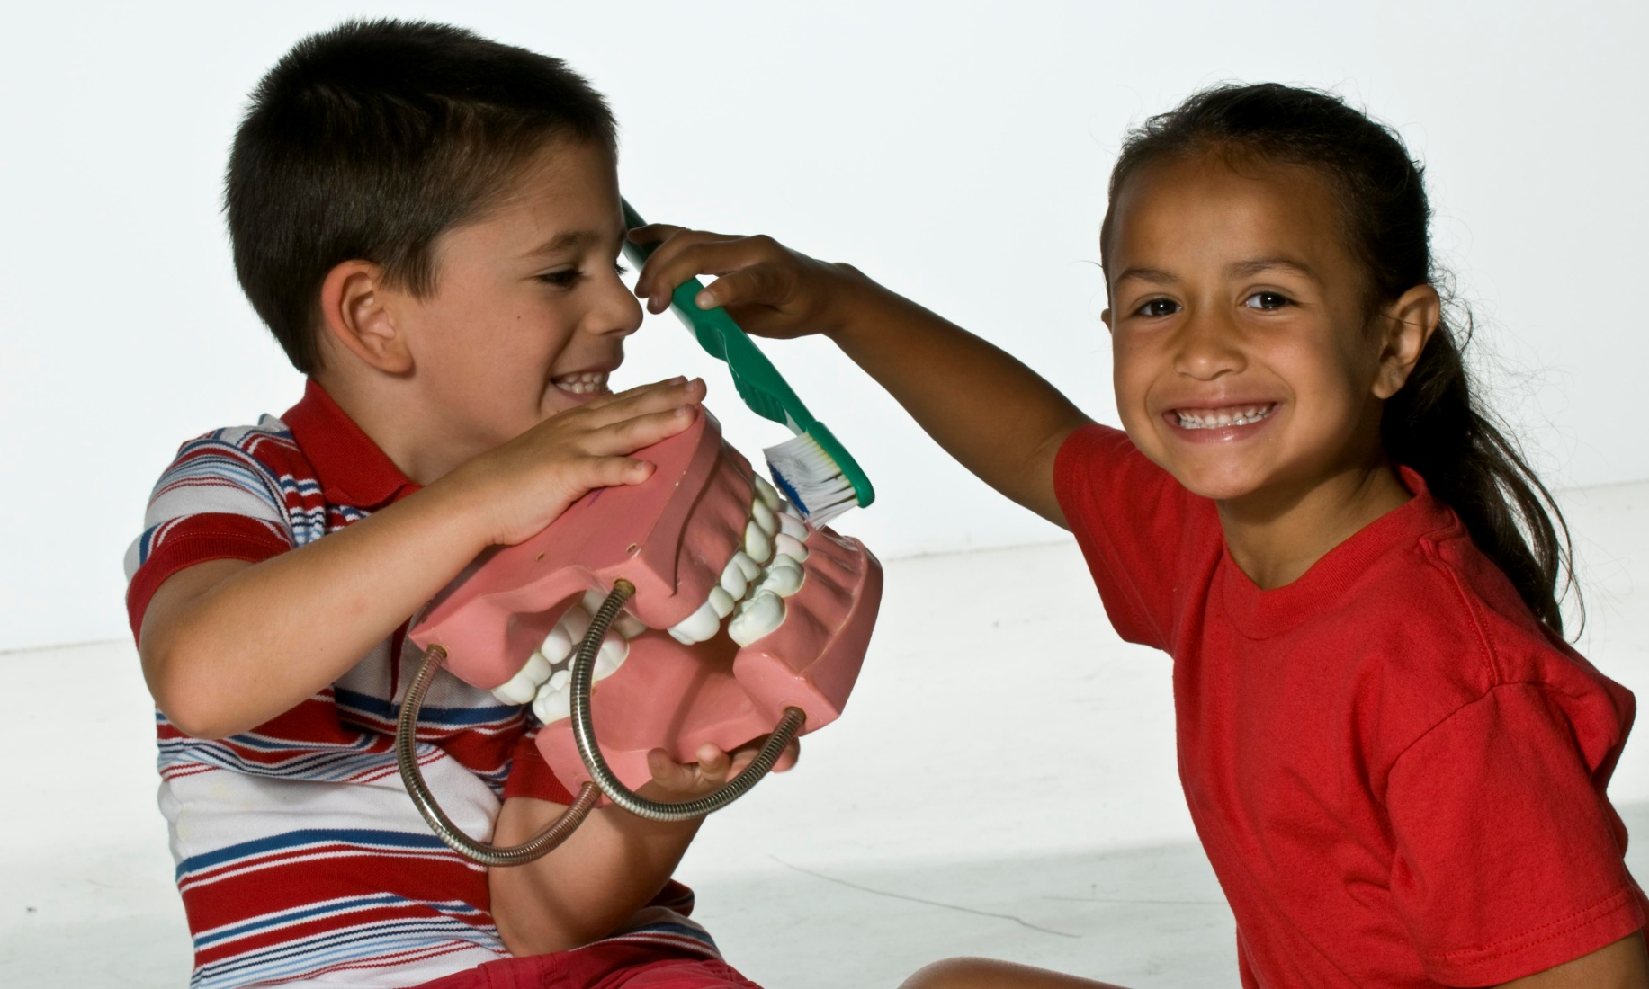
The Oral Health of AI/AN Children
Kathy Phipps, DrPH
Oral Epidemiology Consultant
Dental Support Center
kathyphipps1234@gmail.com

Slide 2
Disclaimer
The findings and conclusions in this presentation are those of the presenter, who is responsible for its content, and do not necessarily represent the views of Indian Health Service. No statement in this presentation should be construed as an official position of IHS or of the U.S. Department of Health and Human Services.

Slide 3
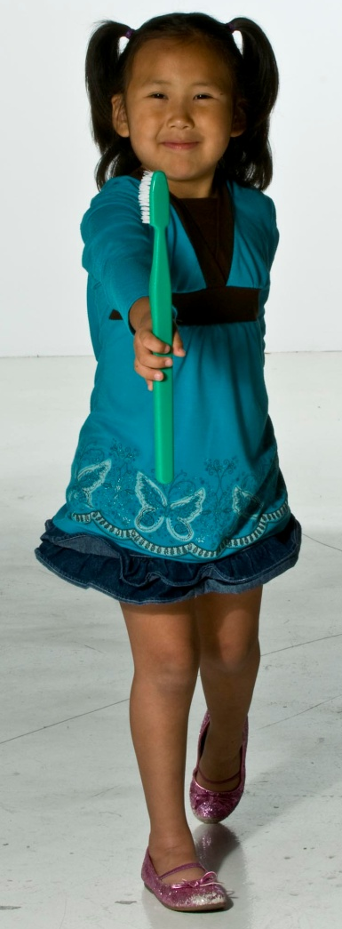
Introduction
Good oral health is important to a child’s social, physical and mental development
Even though tooth decay can be prevented, most American Indian and Alaska Native (AI/AN) children still get cavities

Slide 4
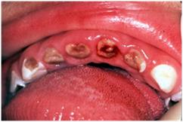
Introduction
If left untreated, tooth decay can
  Affect a child’s growth
  Result in significant pain & infection
  Diminish a child’s overall quality of life
Young Child with
Advanced Decay

Slide 5
Two IHS Oral Health Surveys
Preschool Children 1-5 Years
School Children 6-9 Years
2010
  8,461 AI/AN children
    63 Tribal and IHS sites
  Children screened at
    WIC
    Well-child
    Head Start & Early HS
2011-2012
  15,611 children
    186 schools in 19 states
  Children screened at
    Public, private, BIA schools with 50% or more AI/AN
    K, 1st, 2nd, 3rd grade

Slide 6
Portland Area Only
Preschool Children 1-5 Years
School Children 6-9 Years
594 children
  7 different sites
    Northern Idaho
    Lummi
    Puyallup
    Umatilla
    Wellpinit
    Grand Ronde
    Yakama
792 children
  9 schools
    Warm Springs, OR
    Bellingham, WA
    Harrah, WA
    LaPush, WA
    Neah Bay, WA
    Nespelem, WA
    Omak, WA
    Puyallup, WA
    Taholah, WA

Slide 7
Key Finding #1
Tooth decay is a significant health problem for AI/AN children.

Slide 8
Key Finding #1
Tooth decay is the most common chronic disease of childhood; five times more common than obesity.

Slide 9
Key Finding #2
Early prevention, before the age of two, is essential to reduce the prevalence of tooth decay in AI/AN children.

Slide 10
Key Finding #2
We must focus dental disease prevention efforts on children less than 2 years of age because age two is too late.

Slide 11
Key Finding #3
Many AI/AN children are not getting the dental care they need.

Slide 12
Key Finding #3
35% of 1-5 year olds & 48% of 6-9 year olds in the Portland Area need dental care.
About 5% need urgent dental care because of pain or infection.

Slide 13
Key Finding #4
AI/AN children continue to have more dental disease than other populations in the United States.

Slide 14
Key Finding #4

Slide 15
Key Finding #5
Some IHS Areas are doing better than Portland while children in other IHS Areas have poorer oral health.

Slide 16
Key Finding #5

Slide 17
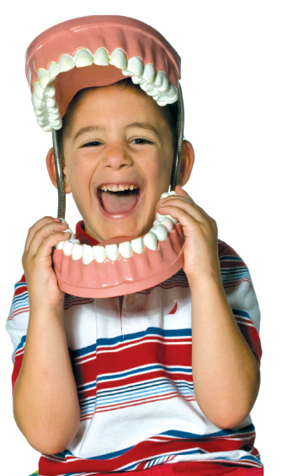
The Big Question
Why do AI/AN children have more tooth decay?

Slide 18
Simple View of Tooth Decay
Child & Teeth
Decay
Oral
Bacteria
Diet

Slide 19
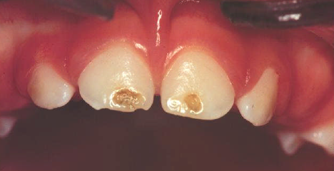
Child & Teeth
AI/AN children erupt their teeth earlier; this increases risk of decay
Poor maternal diet and health may result in poorly formed teeth
Many parents do not brush their child’s teeth daily
Defect in enamel of tooth

Slide 20
Diet
High intake of sugar and carbohydrates at very young age
Many children do not get adequate levels of calcium and Vitamin D

Slide 21
Oral Bacteria
AI/AN children may get oral bacteria earlier
AI/AN children may get a different type of oral bacteria that causes more decay; streptococcus sobrinus
Many parents do not brush their child’s teeth daily

Slide 22
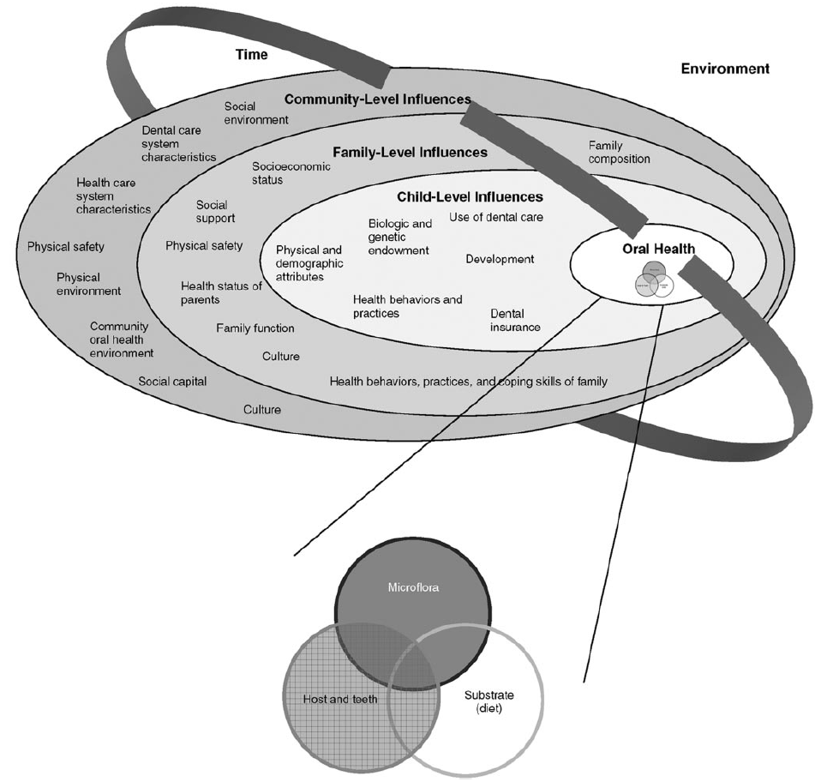
Other Important Considerations
Limited access to dental care
Lower income or poverty
Lower education
Health behaviors
Family stress
In some areas:
Limited access to healthy foods

Slide 23
Potential Actions to Consider
Parent & community education
  Brush children’s teeth daily with fluoride toothpaste
  First dental visit by 12 months
  Limit sugar intake
Implement community based prevention programs
  WIC, Early Head Start, Head Start, well-child visits
  Fluoride varnish and parent education
  Dental sealant programs for older children
  Bill Medicaid for these services to cover costs

Slide 24
Potential Actions to Consider
Implement case-management services
  Identify at risk children and help them access both preventive and curative services
  Can be combined with community based prevention programs
Increase access to dental care
  Optimize Medicaid & insurance billing to cover costs
  Mid-level providers may be an option in the future
  Encourage first dental visit by 12 months

Slide 25
Detailed Data Tables

Slide 26
Results by Clinic, 1-5 Year Olds
Clinic/Site | Number Screened | % with Decay Experience | % with Untreated Decay | Mean Number of Teeth with Decay Experience
Northern Idaho | 77 | 55.3 | 29.8 | 2.55
Lummi | 121 | 65.5 | 51.0 | 5.03
Puyallup | 16 | NA | NA | NA
Umatilla | 67 | 37.0 | 24.0 | 1.71
Wellpinit | 37 | 75.4 | 53.0 | 5.12
Grand Ronde | 39 | 33.2 | 21.5 | 1.44
Yakama | 237 | 51.0 | 35.0 | 3.01
Portland Area Total | 594 | 56.7 | 35.7 | 3.69
Indian Health Service | 8,461 | 54.1 | 38.5 | 3.50
NA: Not applicable, sample size too small to calculate site specific estimates
Decay experience means that a child has had tooth decay sometime in their lifetime
Untreated decay means that the child has decay that has not received appropriate treatment

Slide 27
Results by Clinic, 6-9 Year Olds
Tribe, Service Unit or Clinic | Number Screened | Decay Experience | Untreated Decay | Dental Sealants
Colville Service Unit | 84 | 79.8% | 38.1% | 17.9%
LaPush Dental Clinic | 25 | 96.0% | 56.0% | 36.0%
Lummi Dental | 62 | 93.5% | 53.2% | 27.4%
Quinault/Taholah | 41 | 97.6% | 70.7% | 24.4%
Sophie Trettevik | 76 | 86.8% | 48.7% | 55.3%
Takopid Health Center | 227 | 81.5% | 36.1% | 41.9%
Warm Springs | 218 | 87.6% | 45.4% | 42.2%
Yakama | 59 | 76.3% | 30.5% | 57.6%
Portland Area Total | 792 | 86.7% | 46.7% | 35.7%
IHS Total | 12,511 | 83.1% | 47.4% | 42.1%
Decay experience means that a child has had tooth decay sometime in their lifetime
Untreated decay means that the child has decay that has not received appropriate treatment

Slide 28
Results by School, 6-9 Year Olds
School | City | State | Number Screened | Decay Experience | Untreated Decay | Dental Sealants
Warm Springs Elementary | Warm Springs | OR | 218 | 87.6% | 45.4% | 42.2%
Lummi Nation Elementary | Bellingham | WA | 62 | 93.5% | 53.2% | 27.4%
Harrah Elementary | Harrah | WA | 59 | 76.3% | 30.5% | 57.6%
Quileute Tribal School | LaPush | WA | 25 | 96.0% | 56.0% | 36.0%
Neah Bay Elementary | Neah Bay | WA | 76 | 86.8% | 48.7% | 55.3%
Nespelem Elementary | Nespelem | WA | 38 | 78.9% | 39.5% | 13.2%
Pascal Sherman Indian | Omak | WA | 46 | 80.4% | 37.0% | 21.7%
Chief Leschi Elementary | Puyallup | WA | 227 | 81.5% | 36.1% | 41.9%
Taholah Elementary | Taholah | WA | 41 | 97.6% | 70.7% | 24.4%
Decay experience means that a child has had tooth decay sometime in their lifetime
Untreated decay means that the child has decay that has not received appropriate treatment

Slide 29

Any Questions?

